Slide 1
LWML 104
Your LWML
Designed 4 U
Notes:
Slide 1 - LWML 104: Your LWML Designed 4 U.
1

Slide 2
The purpose of LWML 104 is …
to provide creative information to organize or reorganize an active women's group in the LWML.
Notes:
Slide 2 - The purpose of LWML 104 is to provide creative information to organize or
reorganize an active women's group in the LWML.
2

Slide 3
Designed to …
equip the women of the LWML to actively encourage the development of new or renewed groups that are sensitive and appealing to all God's women.
Notes:
Slide 3 - LWML 104 is designed to equip women of the LWML to actively encourage
the development of new or renewed groups that are sensitive and appealing to all
God's women.
3

Slide 4
4 U to …
help assess, accept, promote, and encourage change, where needed, for flexibility and adaptability to fit programs to people, so that needs of the woman of today are met.
Notes:
Slide 4 - 4 U to help assess, accept, promote, and encourage change, where needed,
for flexibility and adaptability to fit programs to people, so that the needs of today’s
woman are met.
4

Slide 5
4 U to …
assimilate all women so they are actively gathered in Christian fellowship, growing in their relationship with God, and serving Him in love.
Notes:
Slide 5 - 4 U to assimilate all women so they are actively gathered in Christian
fellowship, growing in their relationship with God, and serving Him in love.
5

Slide 6

In the beginning was the Word.
Notes:
Slide 6 - The LWML has many resources to help design your LWML group. Bible study is a great beginning to your design. You may want to consider starting or rekindling your group with a Bible study using LWML resources. As the women become accustomed to meeting together in the Word, you might add time after your Bible study to discuss mission opportunities. As you design, remember the various possibilities of time, frequency, and venue based on the lifestyles of the women in your congregation.

Slide 7
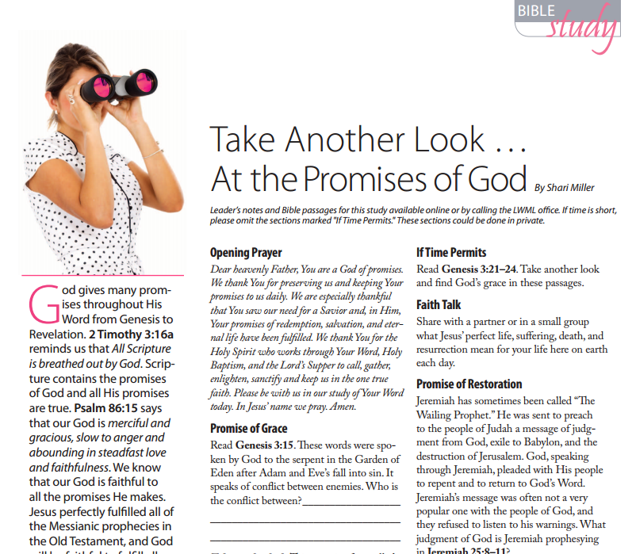
www.lwml.org/bible-studies/quarterly
Notes:
Slide 7 - This is a Bible study from the Lutheran Woman’s Quarterly (LWQ). Some groups order the LWQ for each participant in their group or for all the women in the congregation. LWQ Bible studies are archived and available for you to download from the LWML website, www.lwml.org. You can do Bible study as a group or individually. There are other topics and articles in the LWQ that will encourage the women to become familiar with LWML resources.

Slide 8

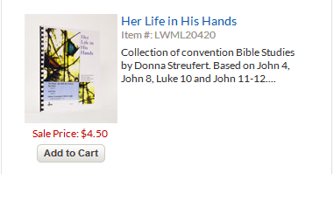
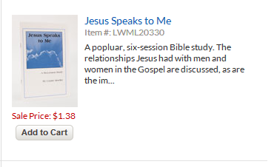

Notes:
Slide 8 - Here are some Bible studies that can be ordered from the LWML Store. Other studies can be downloaded to your computer free of charge. Some studies also have leader guides and student guides. There are studies for many different group sizes and time frames; a survey of the women in your congregation may help you determine which will be best for your group.

Slide 9
Jeremiah 29:11
“For I know the plans I have for you,” declares the Lord, “plans to prosper you and not to harm you; plans to give you hope and a future.”
Notes:
Slide 9 - Jeremiah 29:11 says, “For I know the plans I have for you, declares the Lord,
plans to prosper you and not to harm you; plans to give you hope and a future.”
9

Slide 10
Always keep your focus on God. He will instruct you in His plan of your design or redesign.
Notes:
Slide 10 - Always keep your focus on God. He will instruct you in His plan of your
design or redesign.
10

Slide 11
Challenges
for
Christian
Women in
Today’s
Society
Notes:
Slide 11 - There are many challenges for Christian women in today’s society.
11

Slide 12



Notes:
Slide 12 - A majority of women are employed outside of their homes. Families are scattered across the continent, even around the world. Life is more dangerous due to increasing crime, drug use, highway speeds, and other factors. Moral standards are declining. Although Christianity is a majority faith in the United States, it is a minority religion in the world. Its impact is decreasing in America, too.
12

Slide 13

vity
But we manage.
We make adjustments
to accommodate the
things we need to do.
Notes:
Slide 13 - There are other factors that present challenges. Look at how your family life may have changed over the years: you may rely on fast food, as we have little or no time to cook; you may find that “date nights” with family and friends are a thing of the past; and juggling career, household obligations, children’s sports, and other activities leave you too exhausted for anything but sleeping. But we manage. We make changes in our lives to accommodate the things we need and want to do.

Slide 14
Keep
an
Open
Mind
Notes:
Slide 14 - Keep an open mind, as it could be the beginning of amazing new opportunities. Change is a fact of life!
14

Slide 15

Notes:
Slide 15 - If you don't grow, you'll die! You are encouraged to use this resource as a tool in implementing change. Even one change could improve women's ministry in your congregation or community. Do not fearfully hide by saying “We've never done it that way before.” An organization which continues to grow will need to investigate and embrace change from time to time. We are an organization that wants to be inclusive, relevant, and appealing to all women. Reaching out to all women requires a progressiveness that will benefit the kingdom of God.
15

Slide 16

God also challenges us:
Without vision, the people perish (Proverbs 29:18 KJV).
Notes:
Slide 16 - God also challenges us: Without vision, the people perish
(Proverbs 29:18 KJV). Our task today is to discover God's desire for our LWML group.
We want to create a vision that will motivate the women of our congregations to
become involved in ways that encourage their growth in Christ so that God's Kingdom
may advance. This has been the endeavor of the LWML since its founding in 1942.

Slide 17





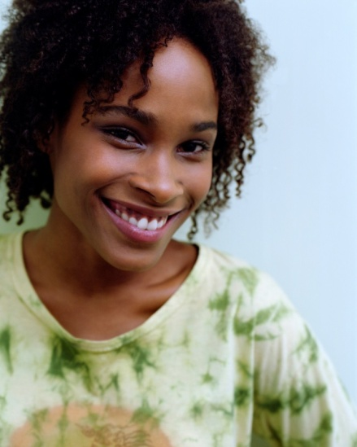

The Women in Your Congregation
Notes:
Slide 17 - If the women in your congregation look like this, they probably have different schedules, interests, and priorities. A survey would help determine what type of LWML group would best fit each woman’s schedule.

Slide 18
LWML Group Possibilities
Within Your Congregation
Glorious Grays
Meet 2nd Thursday of each month, 11:30 a.m., at a restaurant.
MIM
(Mom’s in Mission)
Monthly meeting at someone’s home.
Ladies of Sudan
Ethnic Ministry Mission
Bi-Monthly meetings.
7 p.m.
Trinity Women in Mission
All groups meet together quarterly after worship service.
Mission Technicians
Meet monthly via email and phone conference.
Notes:
Slide 18 – If your congregation only has one LWML group and schedules do not permit some women to attend, consider adding a group to fit the specific lifestyles and schedules of the women in your congregation. Choose a name for your group to describe who you are, remembering that what you do is for Christ.
Here are some LWML group possibilities within your congregation:
The Glorious Grays are women over 60, unemployed or retired, don’t like to attend evening meetings, but enjoy getting together for a luncheon meeting at a restaurant.
Mission Technicians are busy business women on the go. They prefer to stay in touch electronically.
Some groups are designed around ethnicity.
Moms with young children who may want to serve in missions may choose to design a group that accommodates their children.
Remember, though there may be multiple LWML groups in a congregation, the mission is the same.

Slide 19

Notes:
Slide 19 - Every great dream begins with a dreamer. “Dreamers” are creative thinkers. They look at things in an open-ended way, without boundaries or limits. They can imagine a whole concept built upon change and possibilities. They're not afraid to offer ideas that would be considered “out of the box.”
19

Slide 20

Notes:
Slide 20 - “Doers” tend to be down to earth with practical and predictable actions. They can implement ideas. They understand everything that needs to take place before the dream can happen.
20

Slide 21
An organization needs both dreamers and doers. The ideas may come from one, but the implementation may have to come from the other. In this process of developing a new group or remodeling an existing one, it will take both types of personalities.
Notes:
Slide 21 - An organization needs both dreamers and doers. The ideas may come from
one, but the implementation may have to come from the other. In this process of
developing a new group or remodeling an existing one, it will take both types of
personalities.

Slide 22
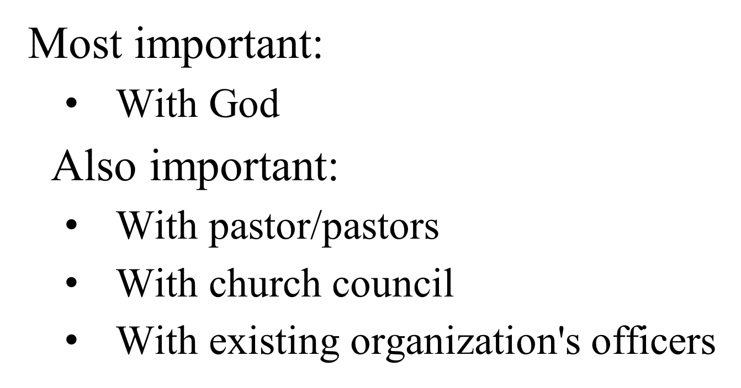

Communication
Notes:
Slide 22 - Communication is important in any organization or reorganization effort.
The most important communication needs to be with God. It is also important that you
communicate with your pastor or pastors, your church council, and with leaders
of any current women's organizations.

Slide 23
Surveys
To assess the needs of your women, conduct a survey of all the women of your congregation. Make it attractive, appealing, and user- friendly. It should be quick to answer, yet allow space for those wishing to say more.
Notes:
Slide 23 - To assess the needs of your women, conduct a survey of all the women
of your congregation. Make it attractive, appealing, and user-friendly.
It should be quick to answer, yet allow space for those wishing to say more.

Slide 24

Survey the women using one of these methods:
Distribute surveys at the worship service(s).
Invite women to an activity where they complete the forms in a group setting.
Use an online survey.
Mail the form.
Notes:
Slide 24 - Survey the women using one of these methods:
Distribute surveys at the worship service(s).
Invite women to an activity where they complete the survey in a group setting.
Use an online survey.
Mail the survey.
Before distributing the survey, make sure you receive permission from your pastor.
If you use an online survey, you will need to have an option for people who do not have
computer access.

Slide 25
Include survey categories for:
Spirituality
Interests
Service
Time Availability
Growth
Assessment
Demographics
Notes:
Slide 25 - Include survey categories for:
Spirituality
Interests
Service
Time Availability
Growth
Assessment
Demographics
Sample surveys are included on the LWML 104 Web page. Feel free to pick and choose questions from each sample, or design your own survey.

Slide 26

Ask for information that will be effective in designing women's groups that are:
Sensitive
Inclusive
Relevant
Attuned
Appealing
Notes:
Slide 26 - Ask for information that will be effective in designing women's groups that are:
Sensitive
Inclusive
Relevant
Attuned
Appealing
Keep in mind that you may need to establish multiple LWML groups to accommodate different meeting preferences and styles.

Slide 27

PRAY
PRAY before you begin designing the survey.
PRAY when you give out the survey.
Ask the women to PRAY before they complete the survey.
PRAY when you compile the information from the survey.
Notes:
Slide 27 - Don't forget to wrap this entire project in prayer.
PRAY before you begin designing the survey.
PRAY when you give out the survey.
Ask the women to PRAY before they complete the survey.
PRAY when you compile the information from the survey.

Slide 28
Assess the Surveys
Assessment of the survey responses will help you understand the participants’ needs and scheduling preferences. Listen to what the responses are, try to understand where they are coming from, and what they are telling you about
their desires.
Notes:
Slide 28 - Assessment of the survey responses will help you understand the participants’ needs and scheduling preferences. Listen to what the responses are, try to understand where they are coming from, and what they are telling you about their desires.
Slide 28 - Assessment of the survey responses will help you understand the participants’ needs and scheduling preferences. Listen to what the responses are, try to understand where they are coming from, and what they are telling you about their desires.

Slide 29
Look for recurring thoughts, words, and themes in the summary sheets of the surveys. These words give direction in writing your purpose statement for the group.
Notes:
Slide 29 - Look for recurring thoughts, words, and themes in the summary sheets of the surveys. These words give direction in writing your purpose statement for the group.

Slide 30
A Purpose Statement is:
A clear concise statement of 25 words or less that clarifies the unique reason or purpose for the existence and efforts of an organization.
Notes:
Slide 30 - A purpose statement is a clear, concise statement of 25 words or less that clarifies the unique reason or purpose for the existence and efforts of an organization.

Slide 31

The mission of the Lutheran Women's
Missionary League is to assist each
woman of The Lutheran Church—
Missouri Synod in affirming her
relation­ship with the Triune God so
that she is enabled to use her gifts in
ministry to the people of the world.
Notes:
Slide 31 - Here is the purpose statement for the LWML. Your group may choose to simply use or adapt this statement: The mission of the Lutheran Women's Missionary League is to assist each woman of The Lutheran Church— Missouri Synod in affirming her relationship with the Triune God so that she is enabled to use her gifts in ministry to the people of the world.

Slide 32
Structuring
The following models will illustrate some possibilities for your organization’s structure. These examples are a beginning for designing a program that fits your group. Flexibility is important.
Notes:
Slide 32 - The following models will illustrate some possibilities for your organization’s structure. These examples are a beginning for designing a program that fits your group. Flexibility is important.
Slide 32 - The following models will illustrate some possibilities for your organization’s structure. These examples are a beginning for designing a program that fits your group. Flexibility is important.

Slide 33
Which Model Fits Your Group?
All Models
Incorporate spiritual growth
Support mites and mission grants
Promote reading of the Lutheran Woman’s Quarterly
Notes:
Slide 33 - Which model fits your group? Let's look at some examples of different models that could be used to meet the needs of the women in your church. While these models represent very different styles, they do have several things in common. Spiritual growth is incorporated in all areas as appropriate. Each group supports district and national LWML mission grants through the offering of monetary gifts (mites). Reading the Lutheran Woman's Quarterly is promoted.
33

Slide 34
Traditional Model
Elected officers
Regular meetings
Plan programs
Plan projects
Notes:
Slide 34 - The Traditional Model functions with elected officers who conduct regular meetings and plan programs and projects.
34

Slide 35
Umbrella Model
This model provides the local group with the opportunity to have more ministry and fewer business meetings, in an effort to assimilate all women of a congregation.
Notes:
Slide 35 - The Umbrella Model provides the local group with the opportunity to have more ministry and fewer business meetings in an effort to assimilate all women of a congregation. It uses an assessment tool such as a survey to identify interests and needs of each woman and promotes formation of different groups within the identified major areas.
35

Slide 36
Umbrella Model
Executive board consisting of major area facilitators
Area facilitators connect with small group leaders and report to executive board
Small groups are formed based on needs or interests
Notes:
Slide 36 - An executive board, consisting of facilitators from each major area, meets to guide this model. Each facilitator of a major area is responsible for connecting with small group leaders and reporting activities and changes to the executive board. Small groups such as Bible studies and prayer groups are formed and each determines its purpose and duration of existence. Spiritual growth is vital to each small group. New small groups are formed as needs or interests arise.
36

Slide 37
Umbrella Model
CONGREGATION
LWML
(Executive Board)
Assessment Tool (Survey)
Spiritual
Growth
Mentoring
Mission
Outreach
Projects
Special
Events
New Member
Assimilation
Ingathering
Chancel Care
Nursing Home Team
Bible
Studies
Mother Daughter
Lunch
Mites
Mothers
Group
Shut-ins
Prayer
Groups
Battered Women’s Shelter
Speakers
Quilting
Women’s
Issues
Notes:
Slide 37 - Here is how an umbrella model might look in a church.
37

Slide 38
LWML Women’s Ministry Model
Within this model, LWML is assimilated throughout the structure as an avenue for spiritual, educational, and mission resources. This is especially effective in congregations that have existing women’s programs outside of LWML.
Notes:
Slide 38 - Within this LWML Women’s Ministry Model, LWML is the basis for each smaller group within the structure as an avenue for spiritual, educational, and mission resources. This is especially effective in congregations that have existing women’s programs outside of LWML. The smaller LWML groups can be effective with their own objectives, as well as helping share the LWML mission via all of the women’s programs in their church.
38

Slide 39
LWML Women’s Ministry Model
Director oversees women’s ministry
Reports to church’s governing committee
Works with major emphasis coordinators
Ministry areas determined from survey
Each ministry area has a coordinator to oversee groups
LWML resources are used throughout
Notes:
Slide 39 - The director may be a paid staff person or a committed volunteer who oversees the entire LWML women's ministry program. She works directly with a governing committee. Her major responsibility is to work directly with the major emphasis coordinators of each target area.
Ministry areas are determined from the survey. As more faith communities are built, more ministry areas may be developed and added to the structure. LWML resources are used throughout.
39

Slide 40
LWML Women’s Ministry Model
Director of Women’s Ministry
Women’s Ministry Committee
(Oversees the following groups)
Bible Study
Retreat
M.O.P.S.
Meals
Altar Guild
Quilters
Prayer Group
Mother-Daughter Event
Ladies Night Out
Book Club
Projects
Notes:
Slide 40 - Here is what an LWML Women's Ministry Model might look like in a church. All groups use LWML resources, support mission grants and mission stories, collect mite donations, pray, and encourage attendance at LWML gatherings in zones, district, and national.
40

Slide 41
Sisters in Mission Model
Notes:
Slide 41 - The Sisters in Mission Model addresses those LWML groups with declining participation. The model provides for the formation of an LWML faith community consisting of sister or neighboring LWML groups who collectively sponsor events and ministry activities.
41

Slide 42
Sisters in Mission Model
Neighboring societies, each with a smaller number of participants, combine to sponsor events and activities.
Encourage and inform women at each congregation.
Each society could have a focus area for planning.
Notes:
Slide 42 - The Sisters in Mission Model has these characteristics:
Neighboring societies, each with a smaller number of participants, combine to sponsor events and activities.
Leaders encourage and inform women of events.
Each society could have a focus area for planning.
The leaders of this model inform women of LWML opportunities at individual congregations and encourage their participation.
Local LWML groups will establish their own model of structure and specialize in a unique interest group that is open to the “sistering” of LWML communities such as quilting, young mother's Bible study, community soup kitchen, nursing home visits, etc.
42

Slide 43
Non-Geographic Model
We have many subsets of society: the workplace, neighborhoods, campuses, military, and communities around the world. This model provides the opportunity for Christian women to share the Gospel where they are.
Notes:
Slide 43 - A Non-Geographic Model is ideal for various subsets of society: the workplace, neighborhoods, campuses, military, and communities around the world. This model provides the opportunity for Christian women to share the Gospel where they are. Spiritual growth is encouraged throughout these communities. The individual LWML group will develop its own unique model to fulfill its purpose for spiritual, educational, service, and mission opportunities.
43

Slide 44
Non-Geographic Model
May or may not have officers
Needs a contact person
Check with your LWML District President
Notes:
Slide 44 - There may not be officers or business meetings with the Non-Geographic Model, although some administration may be necessary to delegate responsibilities. An LWML representative could distribute information to the entire group. Check with your LWML District President regarding membership procedures to be eligible for district convention voting delegates. Perhaps a sponsoring LCMS congregation would be advisable. A mailing address or email address is needed to receive LWML information.
44

Slide 45
Cyber Model
This model utilizes modern technology to bring women together in a welcoming and convenient environment. The advantages are the convenience of time and location. Access to the LWML website offers online resources and information.
Notes:
Slide 45 - The Cyber Model utilizes modern technology to bring women together in a welcoming and convenient environment. The advantages are the convenience of time and location. Access to the LWML website offers online resources and information. With this elimination of boundaries, women can enter into Bible studies and discussion groups as a means for spiritual enrichment and encouragement. Women with similar interests and/or backgrounds can create a network for establishing an LWML group.
45

Slide 46
Cyber Model
Welcoming and convenient
May or may not have officers
Needs a contact person
Might need a sponsoring LCMS congregation
Check with LWML District President
Notes:
Slide 46 - Like the Non-Geographical Society, there may not be officers or regular business meetings, although some administration may be necessary to delegate responsibilities. An LWML representative could disseminate information to the entire group. Check with your LWML District President regarding membership procedures to be eligible for convention voting delegates. Perhaps a sponsoring LCMS congregation would be advisable. A mailing address or an email address is needed to receive LWML information.
46

Slide 47

Cyber Model
e-society
Meetings can take place using electronic media such as email, Web conferences, chat rooms, or Facebook groups.
Guidelines for an e-society can be found on the LWML website at www.lwml.org.
Notes:
Slide 47 - An example of a Cyber Model is an e-society. With this group, meetings can take place using electronic media such as email, Web conferences, chat rooms, or Facebook groups. Guidelines for an e-society can be found on the LWML website at www.lwml.org.

Slide 48


Kick-off Activities
Plan an event:
Not to be missed
Fits purpose statement and
target areas
Publicized as starting a new
group or redesigning an existing
group
Notes:
48
Slide 48 - No matter what model you choose to use, a kick-off event should be planned to get your women's group up and functioning. This should be an activity that fits the purpose statement and target areas. It should also be something that the women won't want to miss. They should know this is being done to kick off the new group or redesign an existing group. As the activity occurs, ownership of the group is ideally taken by those attending. During the event, publicity should be available concerning the times and places of activities, as well as opportunities to become involved in this organization.
Slide 48 - No matter what model you choose to use, a kick-off event should be planned to get your women's group up and functioning. This should be an activity that fits the purpose statement and target areas. It should also be something that the women won't want to miss. They should know this is being done to kick off the new group or redesign an existing group. As the activity occurs, ownership of the group is ideally taken by those attending. During the event, publicity should be available concerning the times and places of activities, as well as opportunities to become involved in this organization.

Slide 49
Recruitment
As areas of service and ministry take shape, more women will join.
Keep women informed
Mentor other women
Notes:
49
Slide 49 - As the areas of service and ministry start to take shape, more women will be attracted as they see themselves a part of the group. Mentor other women by keeping them informed, inviting them to activities, and encouraging their participation as they are assimilated into the group. As the LWML mission statement says, “affirm her relationship with the Triune God so that she is enabled to use her gifts in ministry to the people of the world.”

Slide 50
Opportunities for Group Leadership Positions
Leaders assume responsibilities
Set up board of directors or coordinators, if needed by the model selected
Coordinate with other women’s groups in your congregation
Notes:
Slide 50 - As more women become involved, some will assume leadership responsibilities. This is the time to set up your board of directors or coordinators. It will depend on which model you have chosen and the involvement of your women. If other women's groups exist in your church, you will need to coordinate your schedules and activities.

Slide 51

Evaluation of Your Group
Notes:
Slide 51 - Periodically evaluate your group.
51

Slide 52
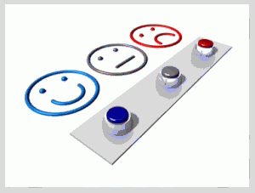
Periodic Checks
Assess what is working, what is not, and what needs to change.
Always look for ways to improve.
Always thank your volunteers and participants.
Be accountable to your pastors, church council, and the congregation at large.
Notes:
Slide 52 - Once you have gone through this whole process of starting a new group, or a renewed group, you'll want to keep up-to-date with periodic checks. As activities are planned, there should always be an evaluation that could change what you might do in the future. Evaluations can be done in written form by the participants, and/or by the planning committee. Make assessments to determine what was good, what was weak, and what you would do differently. Be fair and just, always looking for ways to improve. Always thank your volunteers and participants, as showing grace and mercy are extensions of God's love toward us. Kindness and appreciation are valuable assets. Be accountable to your pastors, church council, and the congregation at large.
52

Slide 53
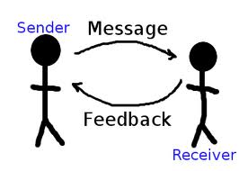
Always communicate, both written and verbally, what your organization is about, what you are doing, and how you can work together to serve the Lord as the body of Christ.
Notes:
Slide 53 - Always communicate, both written and verbally, what your organization is
about, what you are doing, and how you can work together to serve the Lord as the
body of Christ.
53

Slide 54
Reassessment
Are the needs of the women being met?
Aim for your target areas with all of your
activities.
Keep in mind your purpose statement.
Be open to change.
Notes:
Slide 54 - After you’ve completed your check-ups and evaluations, you'll want to
reassess your organization. It's part of staying healthy and fit. Be open to modification
and change. Refer back to your original surveys once a year and be sure you are
addressing the needs that the women identified. If you are aiming for your target areas
with all of your activities, then you will meet the goals successfully.
Always keep in mind your purpose statement and how you operate as an organization
to accomplish that mission.
As time passes, additional information gathering will be needed, possibly through
another survey. Be open to change your objectives and your activities. Don't be afraid
to try new things and try not to use the words “we've never done it that way before.”
An organization that stretches can grow in wonderful ways that we can't even
dream about.

Slide 55
AS LUTHERAN WOMEN IN MISSION
You want to be…
Sensitive
Inclusive
Relevant
Attuned
Appealing
… so that ALL women may grow in Christ!
Notes:
Slide 55 - Reaching out to others is an important part of any organization.
A group that has only in-reach, but no outreach, will suffocate and die.
Remember to design your group for your situation and to welcome each and every
sister in Christ at her comfort level of involvement.
As LWML (Lutheran Women in Mission), you want your groups to be ...
Sensitive
Inclusive
Relevant
Attuned
Appealing
… so that ALL women may grow in Christ!

Slide 56
LWML 104
Your LWML
Designed 4 U
Notes:
Slide 56 - LWML 104: Your LWML Designed 4 U.
56

